Slide 1

Inception: Starting a New Project
Needs and Features
Notes:
‹#›

Slide 2
Needs, Features, and Requirements
Problem Space
Problem
Problem
Needs
Features
The system to be built
Solution Space
Software
Requirements
Traceability
Test Procedures
Design
User Doc

Slide 3
Requirements Exist at Many Levels
What
How
Stakeholder Needs
Product or System Features
What
How
Software Requirements
What
How
Design Spec
Test Procedures
Documentation Plans

Slide 4
What are Needs?
“a reflection of the business, personal, or operational problem (or opportunity) that must be addressed in order to justify consideration, purchase, or use of a new system” - p. 96 Leffingwell & Widrig 2nd ed
Needs can come from any stakeholder
We typically focus on user needs
Needs can be vague and contradictory
Don’t press; some of these will “come out in the wash”
Needs can help you understand the true nature of the problem(s), but you don’t directly implement them

Slide 5
What about Features?
“a service the system provides to fulfill one or more stakeholder needs” - p. 97 L & W
High-level statements of desired behavior
What we want the system to do, not how to do it!
Often the user has translated this some toward a mechanism to realize the feature.
Can be good and bad - work carefully if you want to change the stakeholder’s mind! (change the how, not the what)
Sometimes needs and features are hard to separate
Features are identifiable but not implementable
You can track these
You can scope your project with these
You can define metadata for these (attributes that describe them)
Try to keep small and manageable
You may start to anticipate gaps & inconsistencies (as risks)

Slide 6
The Five Heuristics in Problem Analysis
Gain agreement on the Problem Definition
Simply write the problem down and see if everyone agrees!
Format: “The problem of <description> affects <stakeholders> the result of which <describe impact>.”
Example: “The problem of cash flow affects the R&D unit’s ability to invest in new innovations the result of which is missing time-to-market.”
Understand the Root Causes
Use root-cause analysis and other techniques to ascertain the true problem you are trying to solve (see drill-down)
Identify Stakeholders and End Users
For example, some reasonable starting questions:
Who are the users of the system?
Who pays for (buys) the system?
Who else is affected by the outputs of the system?
Who will evaluate and sign-off on the delivered system?
Who will maintain the system in the field?

Slide 7
The Five Heuristics in Problem Analysis
Define the Solution System Boundary
What is in the system and who interacts with it
Intuitively, you may not be able to pin down exactly what is in the system yet, but you can get agreement on what is not going to be in it!
Some example questions:
Where will the system be used?
Where does the system get its information, or inputs?
What other external systems will this system interact with?
Identify Constraints
“…a restriction on the degree of freedom we have in providing a solution” (p. 55 L&W) - Recall the Engineering Design Process!
Some examples:
Are there financial constraints (for acquisition/outsourcing/special talent)
Is there a political story (will you offend someone, question a sacred cow?)
Are there regulatory constraints in this vertical
Are there market constraints (affects delivery model, time)
Is there a legacy system/code you must build upon?

Slide 8
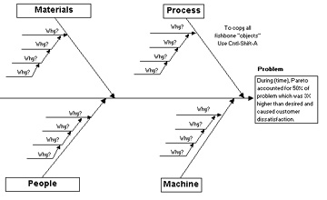

Drill-Down: Step 2 - Understanding the Root Cause
Have you asked your customer WHY they want the project you are implementing?
Lean Development and the 5 Whys:
Ask your customer why they are having the problem they are asking you to solve. When they tell you, ask them “why is that?” When they tell you, ask them “well, why is that?.” When they respond ask them “why is that?” and when they explain ask them again “why?”
The rule is that it can take from 2 to 9 “Why?”s to get to the root cause.

Slide 9
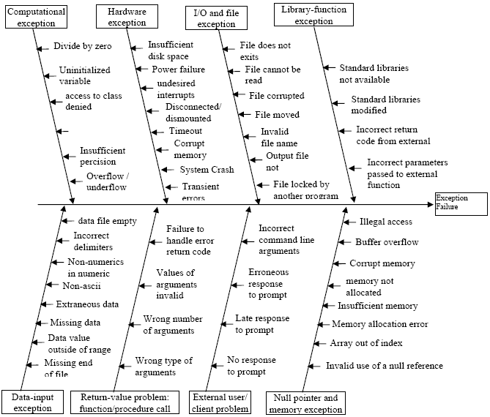
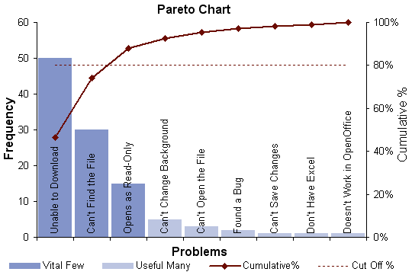
Drill-Down: Step 2 - Tools
Ishakawa (fishbone):
Problem goes in box on right
Possible causes connected off a main axis (“spine”)
Ask Why again – start a mini-skeleton off that cause
Heuristic: the 4Ms: consider Man, Machine, Management, & Method
Pareto Chart:
The 80-20 rule: “80% of the problem is in 20% of the causes”
Lay out causes and give estimate of its contribution to the problem
Display as histogram

Slide 10
Example: Course Registration System
Stakeholder Needs
Need less administrative overhead for registration.
Professors need immediate access to student grades.
Feature
Provides a way to view student information, by semester and by class.
Software Requirement
Functional
The use case starts when the student selects the “register for course” command. The system displays the list of available courses…
Tree browser is a suggested UI metaphor for showing semester & class info
Non-Functional
99% of 24/7 availability (3.65 days downtime per year)
Constraint
Operate on the College’s UNIX cluster.

